Slide 1
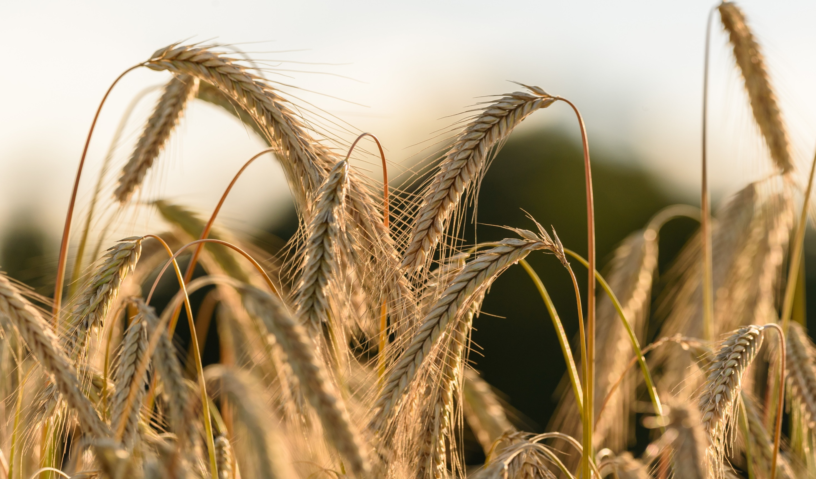


FORK-TO-FARM
AGENT-BASED SIMULATION TOOL AUGMENTING BIODIVERSITY IN THE
AGRI-FOOD VALUE CHAIN
GA MEETING
DATE: May 12-14, 2021
The BioValue project has received funding from the European Union’s Horizon 2020 research and innovation programme under the Grant Agreement No. 101000499

Slide 2


WP3. Task 3.2: Analysis of interlinkages among value chain agents
D3.2 Analysis of the interlinkages among value chain agents (UNIBO, M18) → Deliverable Progress
Task Leader: University of Bologna
The BioValue project has received funding from the European Union’s Horizon 2020 research and innovation programme under the Grant Agreement No. 101000499

Slide 3
Task 3.2: Analysis of interlinkages among value chain agents
Start Month: 10
End Month: 18 (Deliverable)
Main Objective: to know the main chain agents, their market and contractual power, the product’s flows, the contractual characteristics of the exchange, the transmission of price, the attributes required by the different agents (and the effects they have on prices). Each of these elements will be explicitly related to the direct and indirect effects on biodiversity.

Slide 4
Task 3.2: Analysis of interlinkages among value chain agents
Main activities:
1) Analysis of the results obtained during T3.1 activities: interviews with VC experts
2) Elaboration of ad-hoc questionnaires for specific agents along the VC
3) Analysis of results of questionnaires
Role of participants:
Since interviews and questionnaires contain qualitative information, results of both surveys will be analyzed by local partners (Ecozept for France and Germany, Nibio for Norway, Unibo for Italy) in order to provide national reports of supply chains.

Slide 5
Task 3.2: Analysis of interlinkages among value chain agents
Scope:
ECOZEPT (Germany) Cereals (Buckwheat) Fruity Vegetables (Eggplant) Legumes (Lentils) | NIBIO (Norway) Fruity vegetables (Tomato) Legumes (Lentils) Cereals (Buckwheat) | UNIBO (Italy) Leafy vegetables (Sonchus) Legumes (Lentils) Cereals (Buckwheat) | ECOZEPT (France) Leafy vegetables (Sonchus) Legumes (Lentils) Fruity vegetables (Tomato)

Slide 6
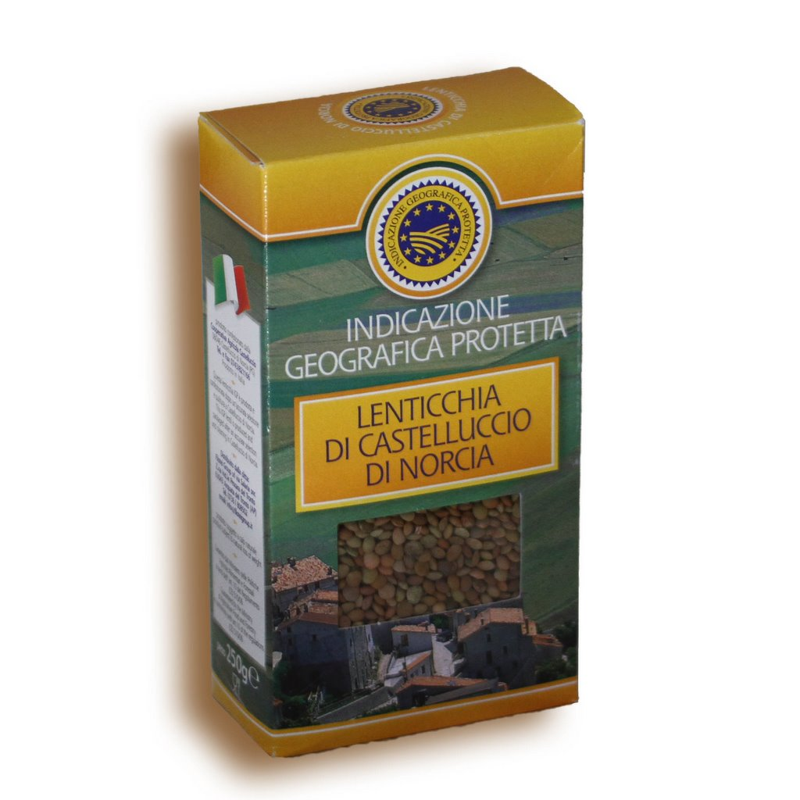

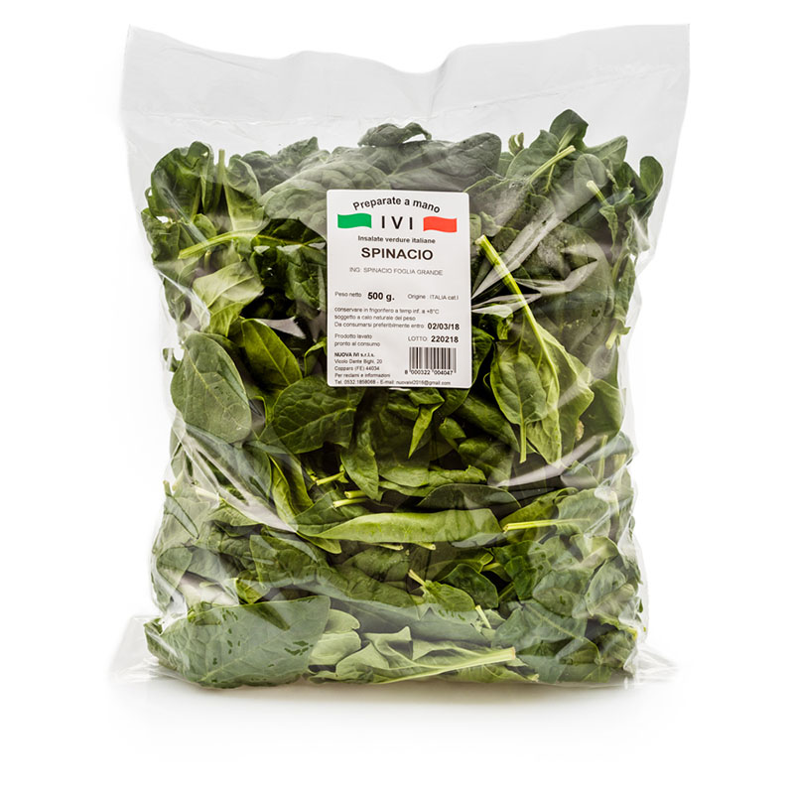
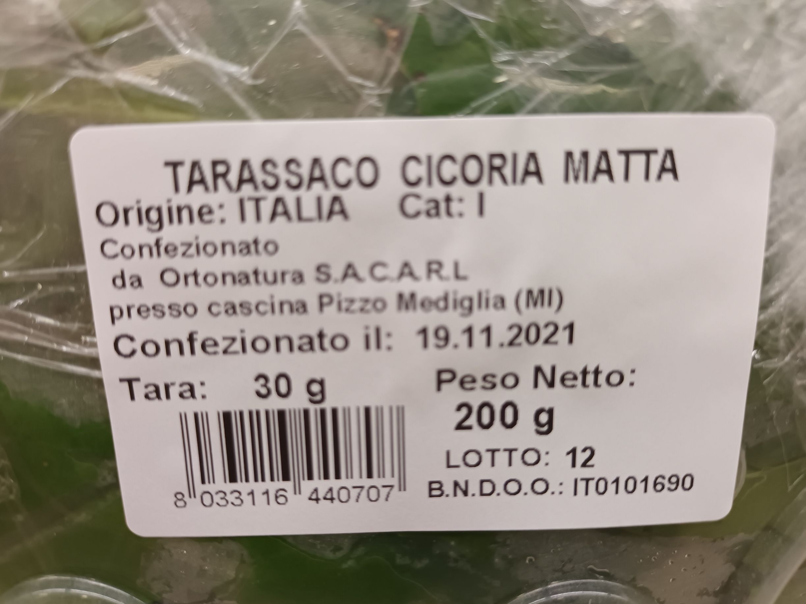




Task 3.2: Value Chain characteristics that are already known: Italy
Specific regional clusters (Umbria, Apulia) , specific landraces, PGI labels
Traditional (regional) final products, PGI
Not cultivated but collected in some region; comparison with main stream (spinach) or alternative leafs (Taraxacum officinale)

Slide 7
Task 3.2: Analysis of interlinkages among value chain agents
Links with WP 4 (collaboration with IDENER):
Results of T3.1 interviews (together with existing literature) will be used to define the variables and the architecture of the ABM
Results of T3.2 questionnaire will be used for the parameterization of the ABM
Links with WP 8 (collaboration with JLU and CAPNUTRA):
8.1.1 Analysis of specific strategies to incorporate biodiversity at the farming level
8.2.1 Analysis of specific strategies to incorporate biodiversity into the food processing practices
8.3.1 Analysis of propensions, attitudes and potential strategies to implement biodiversity paths by retailers

Slide 8
Task 3.2: Structure of the questionnaire with stakeholders
Final version to be decided after the results of the interviews with experts (September-October), with the collaboration of partners from WPs 3, 4 and 8
However, few time to take a final decision on the structure (Deliverable to be ready in March 2022)
Questionnaires have to be realized between October and February 2022

Slide 9
Task 3.2: Structure of the questionnaire
Some indications
Specific questionnaires for agent categories: farmers, processors, (wholesalers), retailers
Different structure of the questionnaire if we deal with:
  A cultivated species where intraspecific biodiversity must be valorized: i.e. varieties/cultivars/landraces of Tomato, Lentil, etc.
  A minor cultivated species that has to compete with other species: buckwheat
  A species that is not cultivated: Sonchus
Differences in specific questions if the enterprise already uses different varieties/cultivars or not; if uses both minor and mayor species or not

Slide 10
Task 3.2: Draft of the questionnaire
Flows
Structure of costs and prices
Drivers of price formation
Providers portfolio
Clients portfolio
Drivers, expectations and bottlenecks for the adoption of new varieties/cultivars

Slide 11



THANK YOU!
Name: Luca Mulazzani
Title: Associate Professor
COMPANY LOGO
Contact
ADDRESS: University of Bologna, Department of Agricultural and Food Science
E-MAIL: luca.mulazzani@unibo.it
The BioValue project has received funding from the European Union’s Horizon 2020 research and innovation programme under the Grant Agreement No. 101000499

